Slide 1
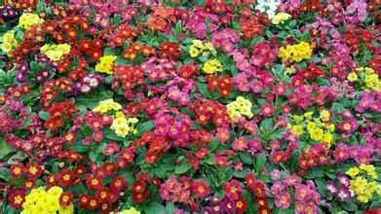
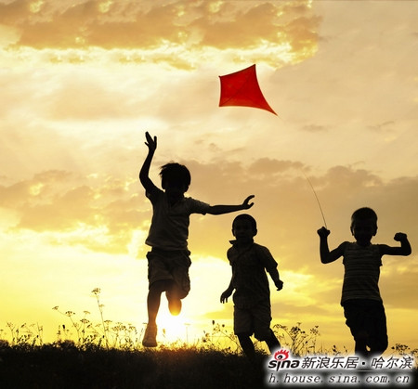
SPRING When it comes to spring,what will you think of?
The sunlight and green trees |  | The colorful flowers | Chun Kun | Fly kites

Slide 2
The Voice of Spring The puff of breeze comes abreast with the charming spring（柔风吹来了迷人的春天） You ought to cheer up as everything is gonna sing(你应该打起精神，因为万物都在歌唱） forget about grie,tomorrow you gotta win(忘记忧伤，明天你一定行） No one is always perfect just as there is no the ever-lasting spring(没人永远至善至美，正如没有永久的春天） Just enjoy the view you’re now owing(就紧紧把握好你现有的风景吧） Haven’t you seen the butterfly napping over the spring(你没瞧见那在喷泉上小憇的蝴蝶吗？）

Slide 3
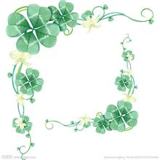
There are four seasons in a year. The first season is spring. The snow begins to melt, the trees sprout and the grass turns green. Spring is so warm that it’s a good time to go outdoors.

Slide 4
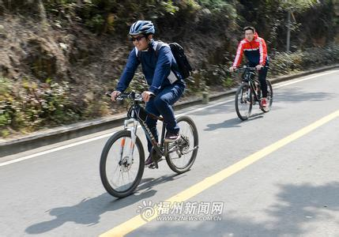
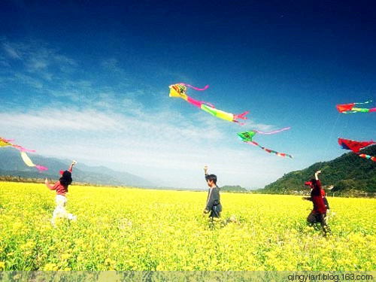
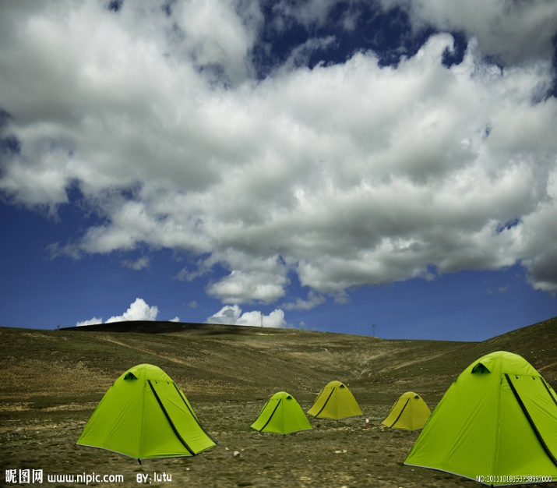
Outdoor Activities

Slide 5
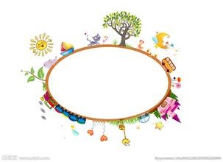
Spring is also a good season for garden.

Slide 6
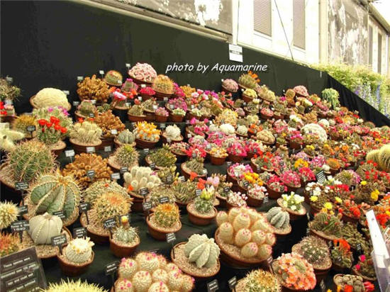
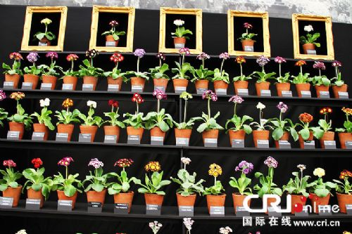
These are some indoor plants. In spring, majority of people cultivate these plants for personal entertainment.

Slide 7
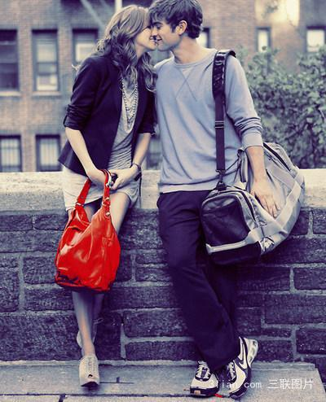
Spring is not only a season when everything turns green,
but also it is a good season for love.

Slide 8
Lovers prefer to go out in this season. Spring can create romantic atmosphere for them. They can go camping, climb mountain, go for picnic and so on.

Slide 9
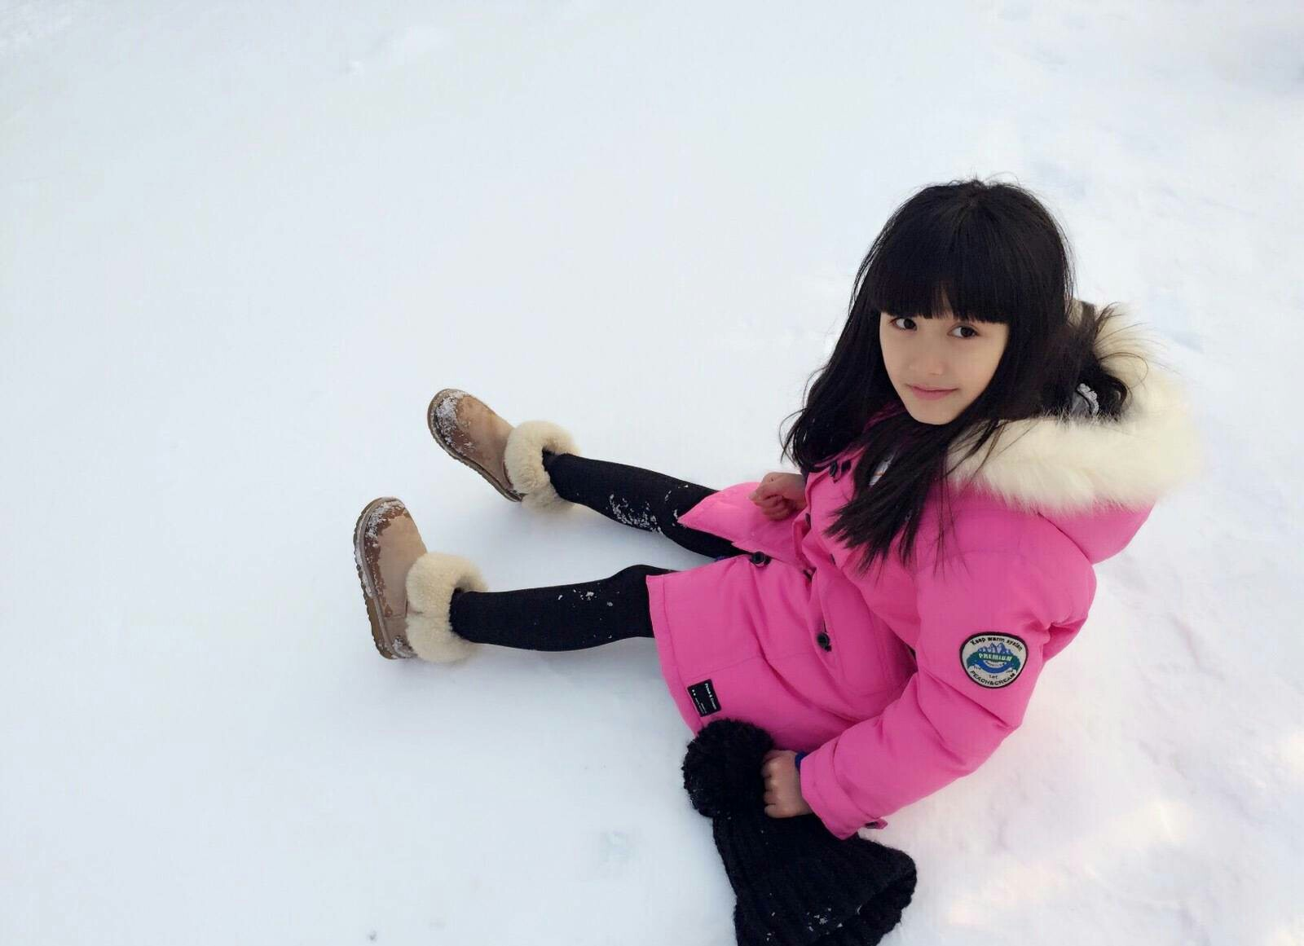
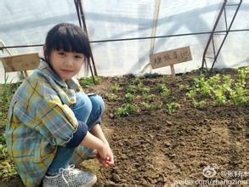
Spring is a season that all things recover. At the same time, the temperature rises. Great changes have taken place in this beautiful season. The change of people’s clothes

Slide 10
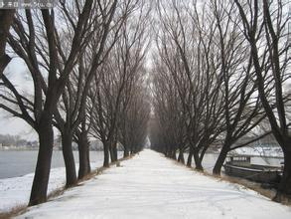
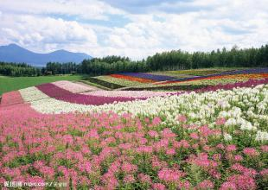
The change of surrounding environment

Slide 11
All scenery around us is fantastic and beautiful.

Slide 12
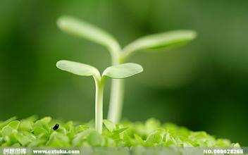
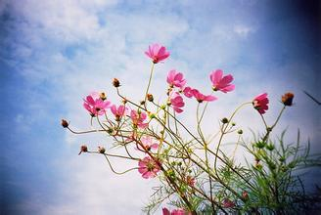
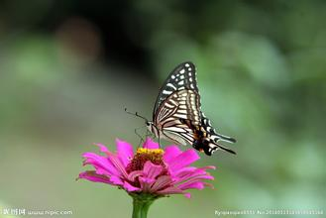
There are more creatures in this season.

Slide 13
There are some proverbs about spring
The beginning of spring rain, rainwater.(立春晴，雨水均）
The water spring, the hundred days of sorrow.(水淋春牛头，农夫百日忧）
Spring, the weather is sunny, Pepsi good harvest.(立春天气晴，百事好收成）
Twelfth lunar month of lunar January Chunshui early spring, late spring.(腊月立春春水早，正月立春春水迟。）

Slide 14
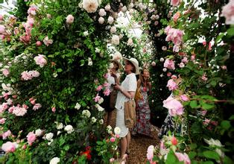
Spring is such a beautiful season. Let’s go to experience it.

Slide 15
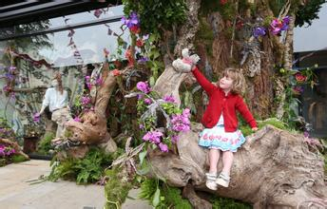
Thank you!

